Slide 1
Difficulty of Diagnosis
ConvNets helping to determine the difficulty of diagnosis by image

Slide 2
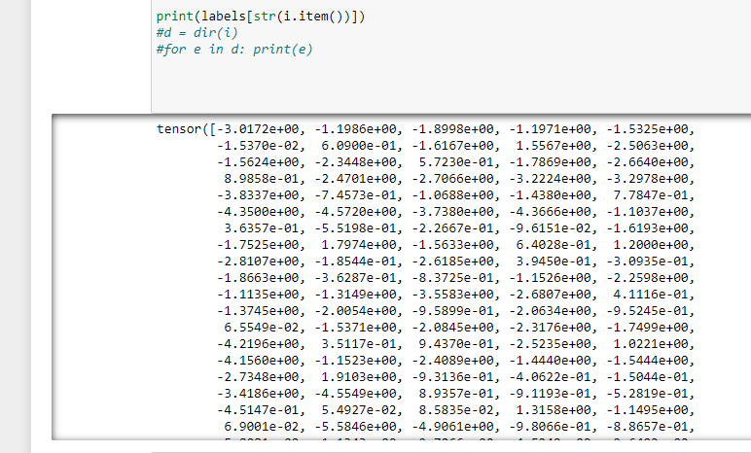
VGG16 outputs the “prevalence”
How much does the CPU feel that that is the actual class

Slide 3
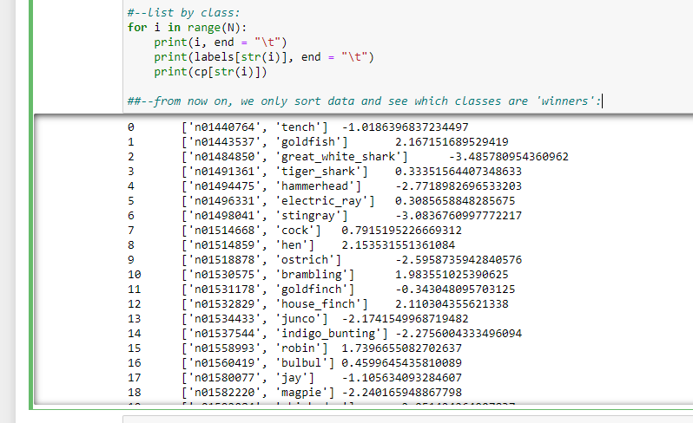
Sorting by the class ID
Just printing each class and its prevalence

Slide 4
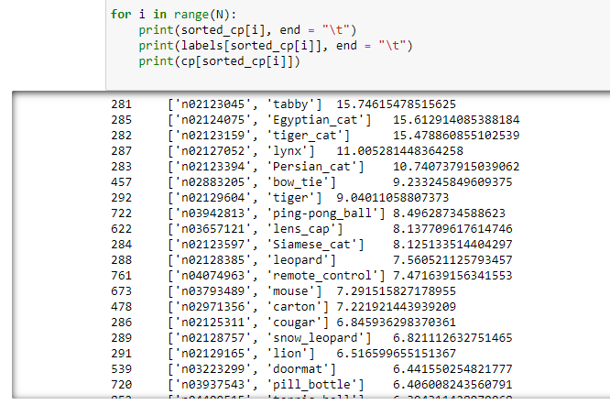
Sorting by Prevalence
Now we see the winner class and other classes

Slide 5
Sorting by Prevalence
Now we see the winner class and other classes
Checking only winner does not seem to be right

Slide 6
Sorting by Prevalence
Now we see the winner class and other classes
Checking only winner does not seem to be right
Since the top three classes are quite close, we may want to think about all three

Slide 7
Sorting by Prevalence
The more close values we have, the more difficult should be visual exam, too.
Difficulty of diagnosis

Slide 8
Further study
More relevant data
Other models that VGG16
Other champions: VGG19, AlexNet, ResNet, LeNet, uNet, etc etc
Homemade architecture
Definition of “difficult diagnosis”

